Slide 1

The Link-Prediction Problem for Social Networks
Maggioni sofia mtr. 75788a

Slide 2

Authors of the paper:
David Liben-Nowell
Department of Computer Science, Carleton College, Northfield, MN 55057.
Jon Kleinberg
Department of Computer Science, Cornell University, Ithaca, NY 14853.
Year of pubblication: 2007

Slide 3
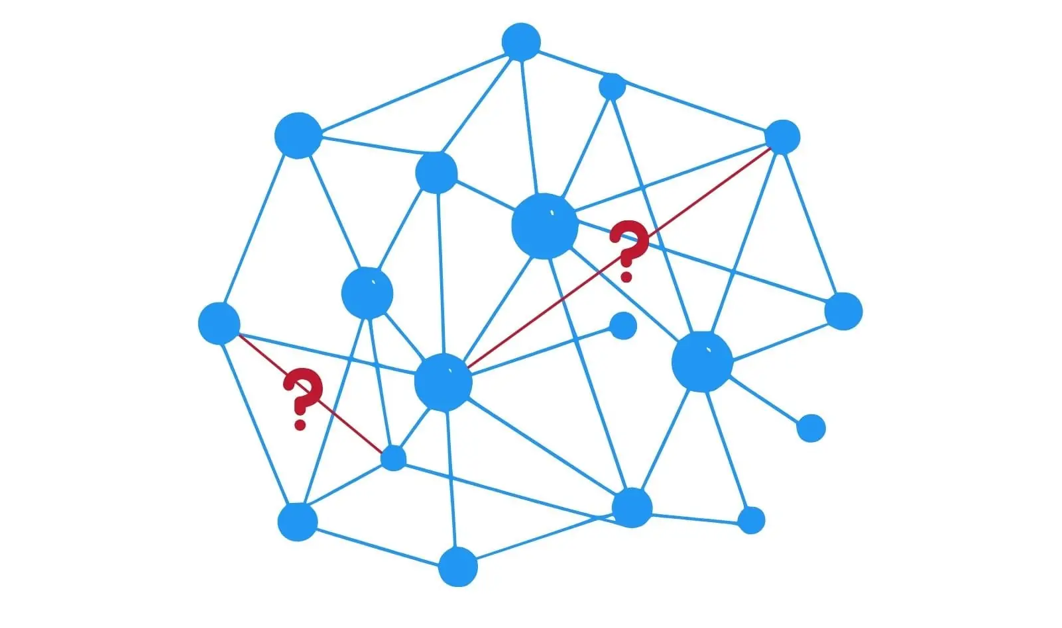
Paper analysis
introduction
Data and experimental setup
Methods for link prediction
conclusion

Slide 4

introduction

Slide 5
SOCIAL NETWORK: structure whose nodes represent people & whose edges represent interaction/collaboration.
Identifying the mechanisms by which they evolve is a fundamental question.
Main goal : which measures of “proximity” in a network lead to the most accurate link predictions.
They are going to study LINK PREDICTION PROBLEM
Link prediction tries to answer this question: «To what extent can the evolution of a social network be modeled using features intrinsic to the network itself ?>

Slide 6
Data and experimental setup

Slide 7
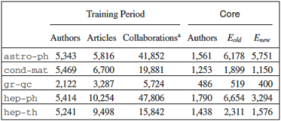
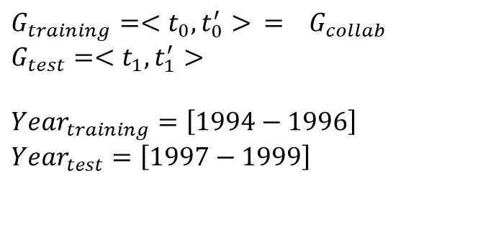
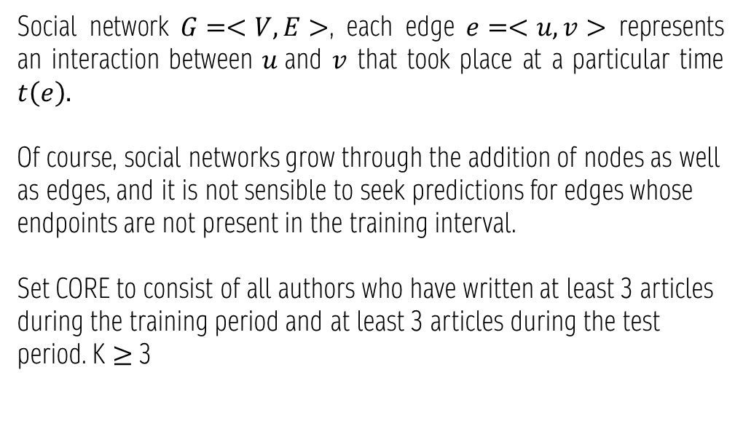
Social network $G=<V,E>$, each edge $e=<u,v>$ represents an interaction between $u$and $v$ that took place at a particular time $t\left(e\right).$
Of course, social networks grow through the addition of nodes as well as edges, and it is not sensible to seek predictions for edges whose endpoints are not present in the training interval.
Set CORE to consist of all authors who have written at least 3 articles during the training period and at least 3 articles during the test period. K $≥$3
www.arxiv.org
A collaboration is an ordered pair of authors who have written at least one article together during the training period.
$G_{training}=<t_{0}, t_{0}^{′}> = G_{collab}$
$G_{test}=<t_{1}, t_{1}^{′}>$
${Year}_{training}=\left[1994−1996\right]$
${Year}_{test}=\left[1997−1999\right]$

Slide 8
Methods for link prediction

Slide 9
METHODS BASED ON NODE NEIGHBORHOODS
Common neighbours
Jaccard coefficient
Adamic/ Adar index
Preferential attachment
METHODS BASED ON THE ENSEMBLE OF ALL PATHS
Katz index
Hitting time
PageRank
SimRank
HIGHER LEVEL APPROACHES
Low-rank approximation
Unseen bigrams
Clustering

Slide 10

Common neighbours
$$score\left(u,v\right)=\left|N\left(u\right)∩N\left(v\right)\right|$$
N(u) is the set of neighbours of u, while N(v) is the set of neighbours of v.
Two nodes are more likely to form a link in the future if THEIR SET OF NEIGHBOURHOOD HAVE LARGE OVERLAP.
In our case the more collaborators they have, the more likely they are to become co-authors.
They use INTERSECTION to grab commor neighbours between u and v.

Slide 11
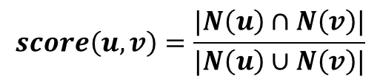
JACCARD’S COEFFICIENT
$$score\left(u,v\right)=\frac{|N\left(u\right)∩N\left(v\right)|}{|N\left(u\right)∪N\left(v\right)|}$$
Measure the probability that both u and v have a feature f; from a randomly selected featuere that either u or v has got.
↓
In our case: the probability that a random collaborator that works with u or v, works with both of them.
This method is against HUB; by normalizing the number of shared neighbours by the total number of distinct neighbours of the two nodes

Slide 12
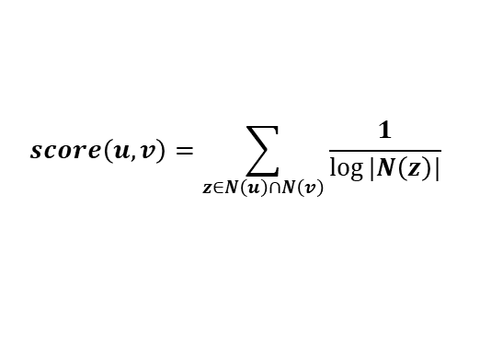
ADAMIC/ADAR
$$score\left(u,v\right)=\sum_{z∈N\left(u\right)∩N\left(v\right)}{\frac{1}{\log{|N\left(z\right)|}}}$$
Differently from Jaccard, this method counting common features by weights rares feature more heavily.
N(z) →THE LOWER THE VALUE, THE RARER THE FEATURE.
Assign each neighboring node z a weight inversely proportional to the logarithm of its degree.

Slide 13

Preferential attachment
«the rich keep getting richer»
The chance that a node joins the network and connects to u depends on how many neighbors u has.
The collaboration between u and v depends only by the fame.
It follows the Barabási-Albert model for the growth of scale-free networks.
→ new nodes connect to existing ones with a probability that is linearly proportional to their degree.
$$score\left(u,v\right)=\left|N\left(u\right)\right|⋅\left|N\left(v\right)\right|$$

Slide 14
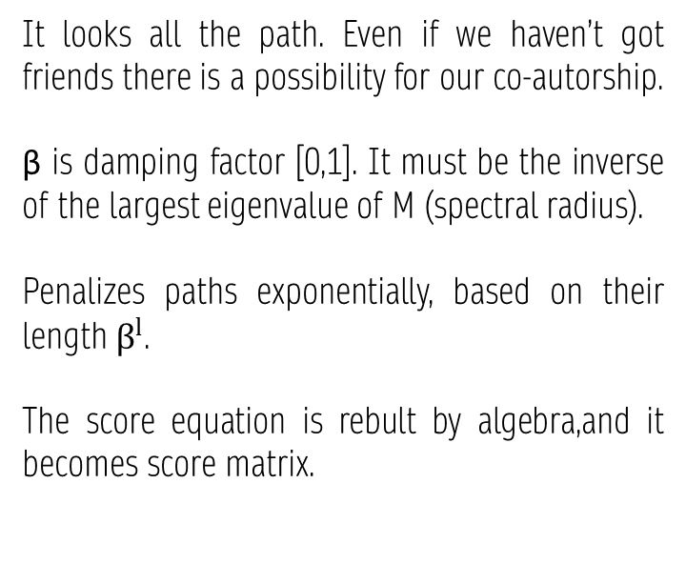
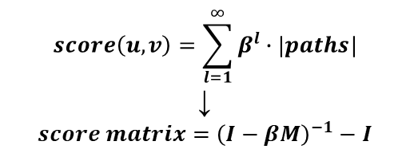
kats
$$score\left(u,v\right)=\sum_{l=1}^{∞}{β^{l}∙|paths|}$$
↓
$$score matrix={\left(I−βM\right)}^{−1}−I$$
It looks all the path. Even if we haven’t got friends there is a possibility for our co-autorship.
β is damping factor [0,1]. It must be the inverse of the largest eigenvalue of M (spectral radius).
Penalizes paths exponentially, based on their length $β^{l}$.
The score equation is rebult by algebra,and it becomes score matrix.

Slide 15
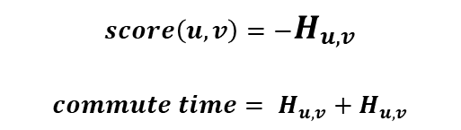
Hitting time
The hitting time from node (u) to node (u) is defined as the expected number of steps required for a random walk starting at (u) to reach (v) for the first time.
The smaller the hitting time, the closer the two nodes are.
Hitting time is not symmetric, meaning that the hitting time from (x) to (y) is generally different from the hitting time from (y) to (x).
To overcome this issue, we consider the commute time, which is symmetric and can therefore be used as a similarity score
$$score\left(u,v\right)=−H_{u,v}$$
$$commute time= H_{u,v}+H_{u,v}$$

Slide 16
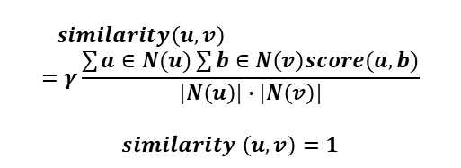
Page rank /
SimRank
$$similarity\left(u,v\right)=γ\frac{\sum{a∈N(u)\sum{b∈N\left(v\right)score(a,b)}}}{|N\left(u\right)|∙|N\left(v\right)|}$$
$$similarity \left(u,v\right)=1$$
Define score(x, y) under the rooted PageRank measure with parameter α [0, 1] to be the stationary probability of v in a random walk that returns to u with probability each step, moving to a random neighbor with probability 1.
Two nodes are similar if they are joined similar neighbours.
γ = decay constant less near one to another less contribution

Slide 17
Low-rank approach / unseen bigrams / clustering
This methos use matrix M, and in particular his rank. Thanks to that they can remove rumour in the graph. On this matrix we can calculate both Katz and Common neighbours. → SPECTRAL DECOMPOSITION.
If the common neighbors of u and v are themselves strongly connected (forming cliques or dense triangles), the social pressure to close the link between u and v is much higher compared to a situation where the common neighbors are isolated from each other.

Slide 18
Results’s analysis
Link Prediction task is highly imbalanced due to the sparsity of the network. For this reason the reported values represent the Improvement Factor (IF) relative to a Random Predictor (RP).

Slide 19
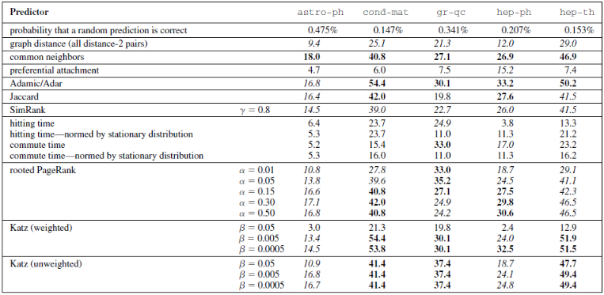
The graph alone allows me to carry out effective link prediction, since it far surpasses the random predictor.
Adamic/Adar manages to clean up the local neighborhood by penalizing the hubs using the logarithmic scale
The Hitting Time is heavily affected by the hub bias
Katz extracts the clean signal by calculating the convergence across all global paths in the network

Slide 20
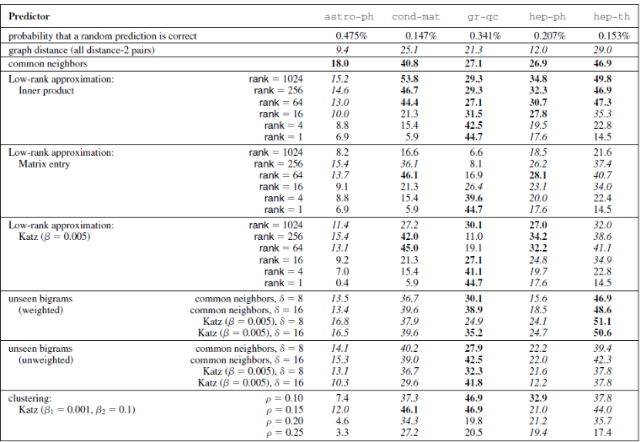
The subcommunity of scientists dealing with General Relativity (gr-qc) has an intrinsically very simple collaborative structure. For this reason, the value increases as the rank decreases.

Slide 21
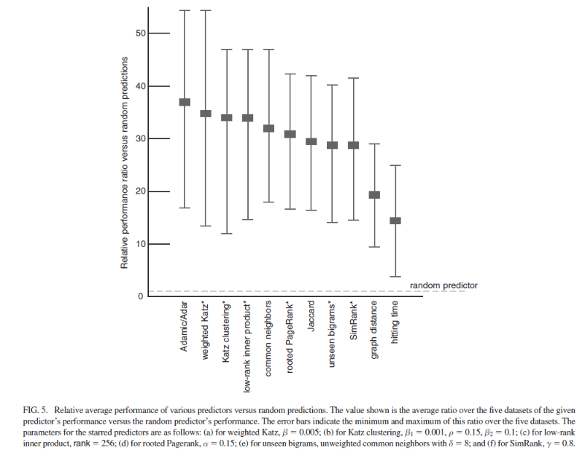
Max value
How better is the algorithm
Min value
Media performance based on all five datasets
Here the problem are hub as I said before
They decide to put it at 1.0

Slide 22
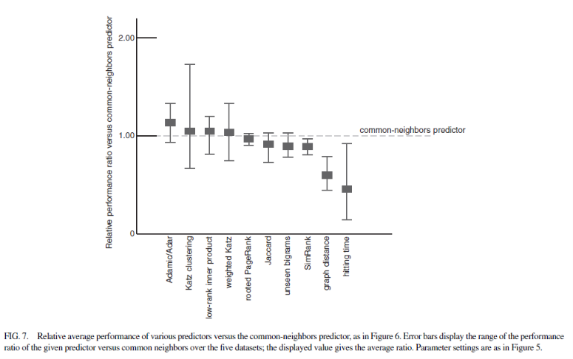
These are over the row, so are more efficient than the others

Slide 23
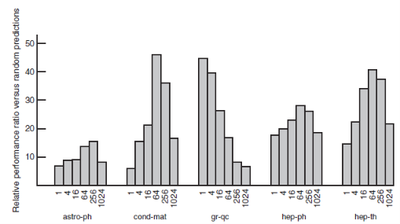
The subcommunity of scientists dealing with General Relativity (gr-qc) has an intrinsically very simple collaborative structure. For this reason, the value increases as the rank decreases.

Slide 24
conclusion

Slide 25
Topology alone is a strong clue for induction
The transition from Local information to Global information
Overcoming classic heuristics (The bridge to modern embeddings)

Slide 26
coding
I decided to generate two different code; one based on FEATURE ENGINEERING, the other one based on GCN

Slide 27
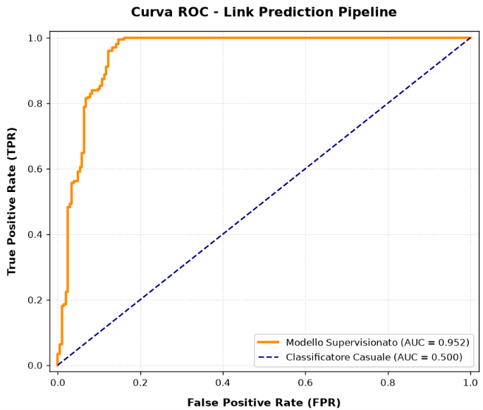
% real future link, the closer it is to one, the better
It is fondamental to evaluate the quality of my link prediction
The AUC expresses the probability that the model will give a higher link probability score to a pair of nodes that will actually connect in the future compared to a randomly chosen pair of nodes that will never connect.
All the topological feature
Couple of nodes that are not going to create links
Code in on my VSC

Slide 28
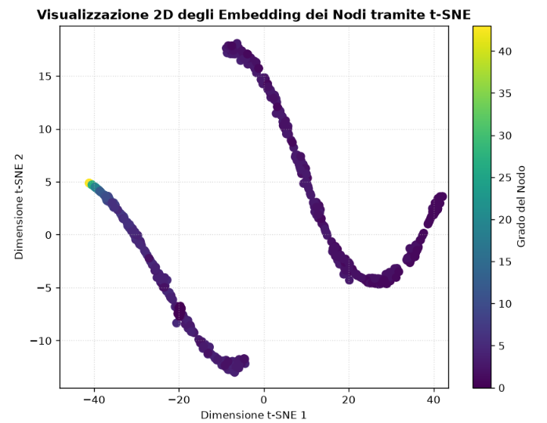
Yellow represnet HUBS
This is like a cluster

